Slide 1
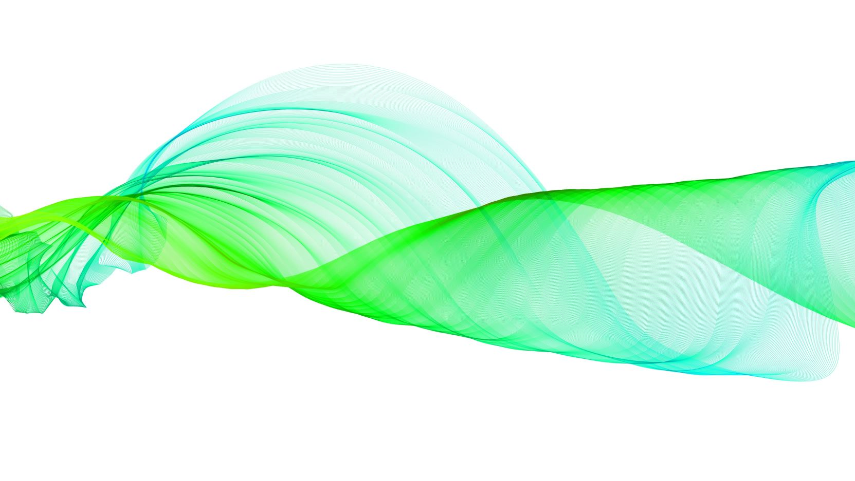
Breathing and Body Scanning
Mindfulness

Slide 2
Understanding our stress containers

Slide 3
Three-minute breathing space

Slide 4
Mindfulness of breath: 4-minute body scan meditation

Slide 5
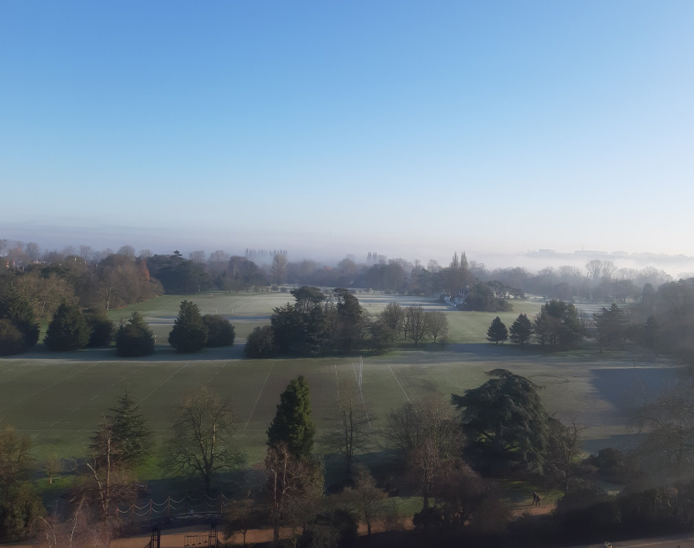
Mindfulness of breath: 10-minute meditation

Slide 6
Box Breathing
When can we use this method?
Before or during stressful events for us
As part of a pre-sleep routine
Benefits?
To reduce stress
Promote calm and reframing
Can improve mental focus
Can improve mood

Slide 7
4-7-8 or “relaxing breath” breathing
Breathing in through the nose for four seconds, holding the breath for 7 seconds, and then exhaling out through the mouth for 8 seconds
Develop the ability to play with the duration of the inhale and exhale so that it works for you

Slide 8
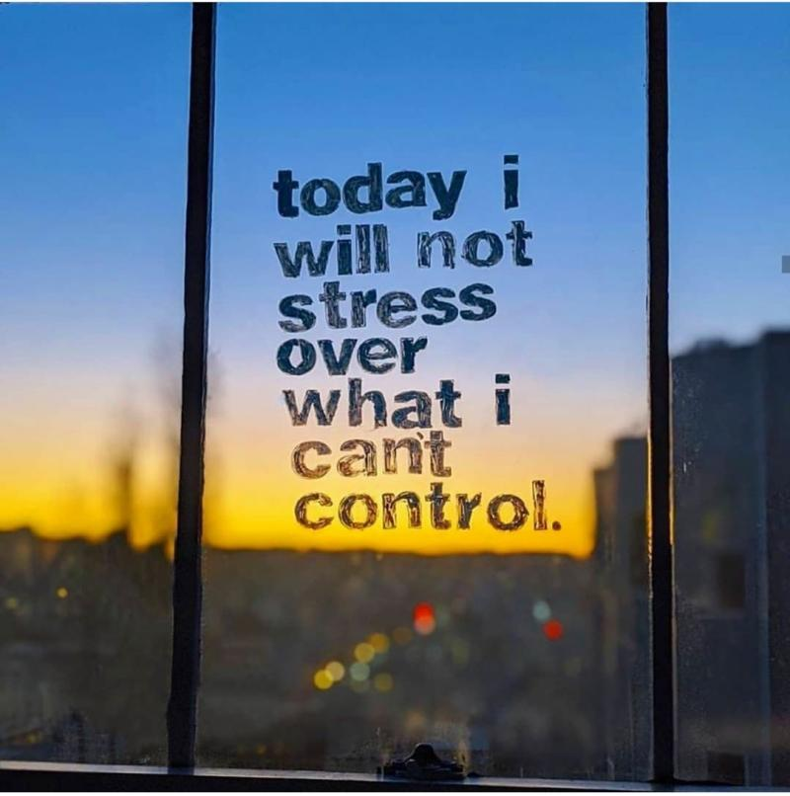
What steps can you start to take?

Slide 9
Everyday mindfulness practices amid extraordinary times (Andy Phee)

Slide 10
Connecting when self-isolating and social distancing (Liz Lord)

Slide 11
Resourcing ourselves
Guided Visualisations
Notes:
Use your power of imagination to take you to places that resource you, e.g. guided visualisations
Resourcing ourselves: somewhere I feel safe/ somewhere I like to be/ a special place for me is …
Close your eyes and imagine yourself to be there right now
Inviting you to look around you and notice what you see
Learning to find and step into these places
How would you feel if you were there now?
The choice you have to take yourself to a safe/ special place

