Slide 1
OULTC Tennis
Meditation
Mental Training Tips
Physical training tips

Slide 2
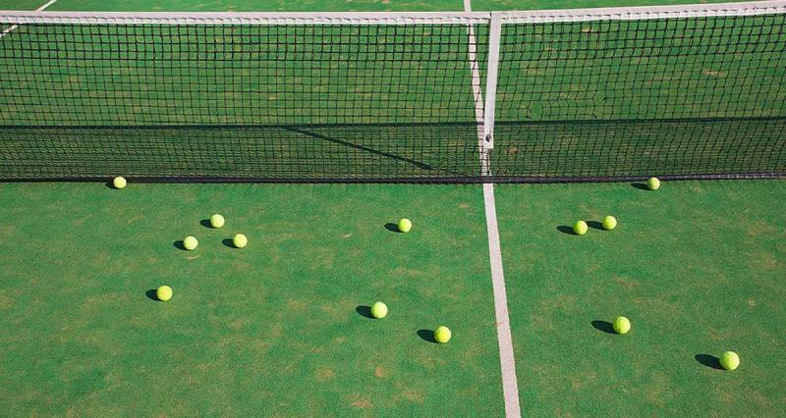
Body scan and guided meditation

Slide 3
Resources
https://www.mindful.org/free-mindfulness-resources-for-calm-during-covid-outbreak/
https://www.headspace.com/meditation/sport

Slide 4
Tennis meditation

Slide 5
Tennis wall training ideas

Slide 6
Glimpse at some of the training drills used by the pros

Slide 7
Tricks

